Slide 1
Census 2021
Prescot, Whiston, Cronton and Knowsley Village Township Profile
Wards: Prescot North, Prescot South, Whiston and Cronton

Slide 3
PWCKV: Population
29,786 people live in the PWCKV township
Since Ward boundaries changed in 2016, the total size of PWCKV’s population (estimated at 28,693 in 2016) has increased by 3.7% (1093 in total)
PWCKV is the second smallest township by population
The proportions of young people, working aged people and those 65 and older living in PWCKV is typical of Knowsley overall.
The Knowsley Offer
Population
National Identity
Religions
Ethnicity
Qualifications
Work
Health and Disability
22.4%
59.4%
18.2%
Of residents are aged 0-19 years old
Of residents are aged 20-64 years old
Of residents are aged 65+ years old

Slide 4
PWCKV: Population
Between 2011 and 2021…
The ward boundaries changed between the two censuses, in 2011 the wards that made up Huyton were: Prescot East, Prescot West, Whiston North and Whiston South
It can be estimated that:
There has been a 4.6% increase in total population (28,402 in 2011 to 29,786 in 2021).
The biggest increase in population was in the 25-29 years (19.5%), followed by the 60-64 years (11.9%), then the 55-59 years (7.9%)
16-19 years category saw the largest decrease (-24%), followed by 20-24 years (-9.3%), these were the only two age categories where the population did not increase.
This is typical of Knowsley as a whole, with significant population dips in these age groups.
The Knowsley Offer
Population
National Identity
Religions
Ethnicity
Qualifications
Work
Health and Disability

Slide 5
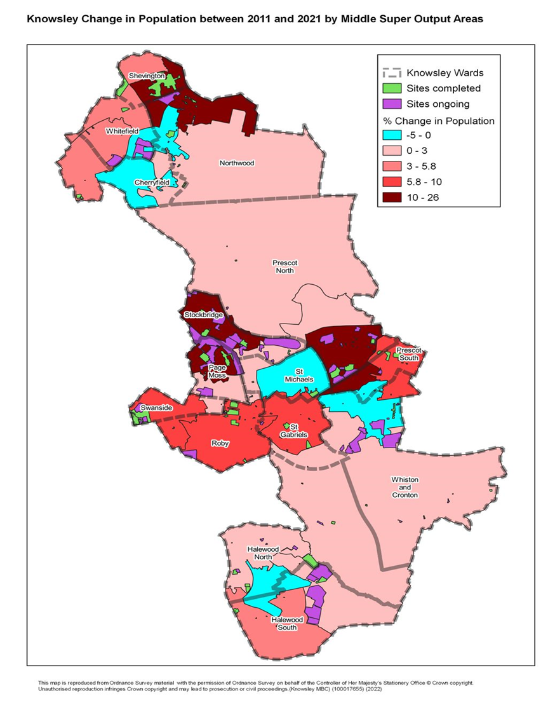
PWCKV: Population
The Knowsley Offer
Population
National Identity
Religions
Ethnicity
Qualifications
Work
Health and Disability
This maps shows the areas of population change between 2011 and 2021
Prescot North has seen the biggest increase in population
Prescot South has also seen growth
Whiston and Cronton has seen the least growth in the area

Slide 6
PWCKV: National Identity
94.5% of PWCKV’s population were born in the UK.
2.5% were born elsewhere but have lived in the UK for 10 years or more.
0.67% of the population have lived in the UK for less than 2 years.
The Knowsley Offer
Population
National Identity
Religions
Ethnicity
Qualifications
Work
Health and Disability
Top nationalities among Kirkby Residents:
British
Indian
Polish
English
Irish
Welsh

Slide 7
PWCKV: Religions
66% of PWCKV’s population identify as being Christian, the same as Knowsley overall. Knowsley has the highest proportion of people who identify as Christian in England & Wales.
The Knowsley Offer
Population
National Identity
Religions
Ethnicity
Qualifications
Work
Health and Disability
28% of PWCKV’s population identify as having no religion. This group of people has increased the most since 2011 across Knowsley.
0.6% of PWCKV’s population identify as being Hindu.
0.5% of PWCKV’s population identify as being Muslim.
4.9% of people did not provide an answer to this Census question.

Slide 8
PWCKV: Ethnicity
In PWCKV:
94.3% of residents are from White ethnic groups
1.5% are from Mixed or Multiple ethnic groups
3.0% are from Asian, Asian-British or Asian-Welsh Backgrounds
0.8% are from Black, Black-British, Black-Welsh, Caribbean or African ethnic groups
0.4% are from Other ethnic groups.
The Knowsley Offer
Population
National Identity
Religions
Ethnicity
Qualifications
Work
Health and Disability

Slide 9
PWCKV: National Identity, Religion, and Ethnicity
PWCKV has the lowest proportion of those born in the UK out of all townships in Knowsley, after Halewood
The Knowsley Offer
Population
National Identity
Religions
Ethnicity
Qualifications
Work
Health and Disability
PWCKV has the highest proportion of those reporting as Hindu out of all townships in Knowsley
PWCKV has the highest proportion of Asian, Asian-British or Asian-Welsh ethnic groups out of all townships in Knowsley
43%
Increase in the number of Knowsley residents from Asian, Black, Mixed or other ethnic groups, since 2011.

Slide 10
PWCKV: Qualifications
22.8% of PWCKV township residents have no qualifications
The Knowsley Offer
Population
National Identity
Religions
Ethnicity
Qualifications
Work
Health and Disability
10.2% have Level 1 qualifications
14.6% have Level 2 qualifications
18.1% have Level 3 qualifications
26.6% have Level 4 qualifications or above
Nationally, Level 4 qualifications are the most common at 33.8% of residents.
The second most common category was no qualifications at 18.2%.

Slide 11
PWCKV: Work
74.9%
Economically Active
of whom 4% are Unemployed
25.1% Economically Inactive
The Knowsley Offer
Population
National Identity
Religions
Ethnicity
Qualifications
Work
Health and Disability
Nationally:
75.4% of the population are economically active
Of whom 4.4% are unemployed
24.6% are economically inactive
Based on those aged 16 to 64 years

Slide 12
PWCKV: Work
Top 5 Industries for Kirkby Residents
The Knowsley Offer
Population
National Identity
Religions
Ethnicity
Qualifications
Work
Health and Disability
2,188 residents work in wholesale & retail trade
3,021 residents work in human health & social work activities
1,209 residents work in construction
1,129 residents work in education
1,059 residents work in manufacturing

Slide 13
PWCKV: Work
4735 (25.1%) residents are economically inactive
Top 4 reasons for being inactive:
The Knowsley Offer
Population
National Identity
Religions
Ethnicity
Qualification
Work
Health and Disability
12.2% are retired
30.5% are long-term sick or disabled
21.3% looking after family or home
19.8% are students
Based on those aged 16 to 64 years

Slide 14
PWCKV: Qualifications and Work
PWCKV has the second highest proportion of residents with no qualifications out of all Knowsley townships, after Kirkby
The Knowsley Offer
Population
National Identity
Religions
Ethnicity
Qualification
Work
Health and Disability
PWCKV has the highest proportion of residents in employment out of all townships
PWCKV has the joint highest proportion of 16–64-year-olds economically inactive because they are students
PWCKV has the highest proportion of 16–64-year-olds economically active out of all of Knowsley townships.
Acorn profiles show just over 42% of employed residents earn less than £20,000 and 32% earned between £20,000 and £40,000

Slide 15
PWCKV: Health and Disability
78%
of PWCKV residents describe their health as good or very good
The Knowsley Offer
Population
National Identity
Religions
Ethnicity
Qualifications
Work
Health and Disability
7.9%
of PWCKV residents describe their health as bad or very bad
21.8%
of PWCKV residents describe themselves as
being disabled
30%
Of PWCKV residents face health challenges according to Acorn profiles
5321
PWCKV residents provide unpaid care, with 1,067 residents stating that they provide 50+ hours per week of unpaid care

Slide 16
PWCKV: Health
6.9%
More residents reported their health as good or very good in 2021 compared to 2011
The Knowsley Offer
Population
National Identity
Religions
Ethnicity
Qualifications
Work
Health and Disability
PWCKV has the second lowest proportion of those rating their health bad or very bad, after Halewood
PWCKV has the second lowest proportion of those describing themselves as disabled
PWCKV has the second highest proportion of residents providing unpaid care (19%), and the highest proportion of residents stating that they provide less than 19 hours per week of unpaid care (25.5%)

