Slide 1

Census 2021
Kirkby Township Profile
Wards: Cherryfield, Northwood, Shevington, Whitefield

Slide 2
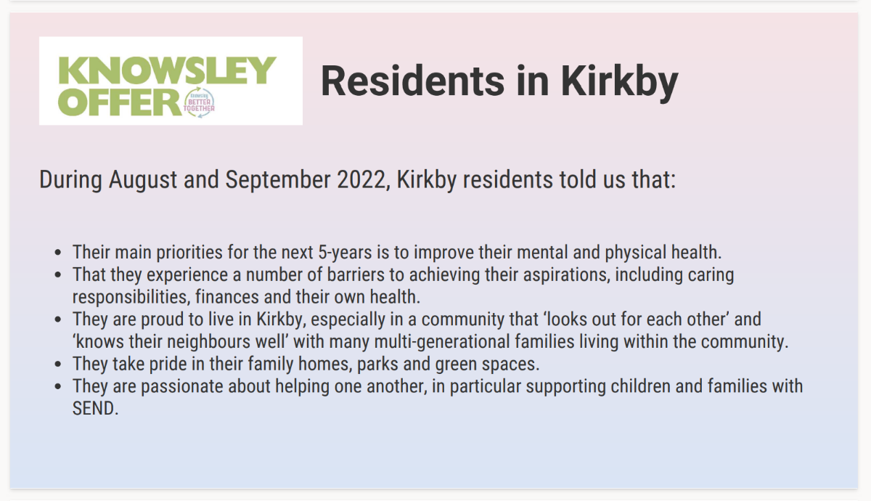

Slide 3

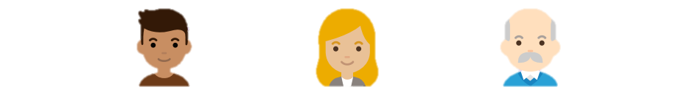
Kirkby: Population
43,831 people live in the Kirkby township
Since Ward boundaries changed in 2016, the total size of Kirkby’s population (estimated at 41,476 in 2016) has increased by 5.7% (2,355 in total)
Kirkby is the second largest township by population
The proportions of young people, working aged people and those 65 and older living in Kirkby is typical of Knowsley overall.
The Knowsley Offer
Population
National Identity
Religions
Ethnicity
Qualifications
Work
Health and Disability
25.8%
59%
15.2%
Of residents are aged 0-19 years old
Of residents are aged 20-64 years old
Of residents are aged 65+ years old

Slide 4
Kirkby: Population
Between 2011 and 2021…
The ward boundaries changed between the two censuses, in 2011 the wards that made up Kirkby were: Cherryfield, Kirkby Central, Northwood, Park, Shevington, Whitefield
It can be estimated that:
There has been a 22% increase in total population (49,301 in 2011 to 60,147 in 2021)
The biggest increase in population was in the 85 years and older category (65%), followed by the 60-64 years (47%), then the 25-29 years (44%)
16-19 years category saw the largest decrease (-12%), followed by 20-24 years (-4%), these were the only two age categories where the population did not increase.
This is typical of Knowsley as a whole, with significant population dips in these age groups.
The Knowsley Offer
Population
National Identity
Religions
Ethnicity
Qualifications
Work
Health and Disability

Slide 5
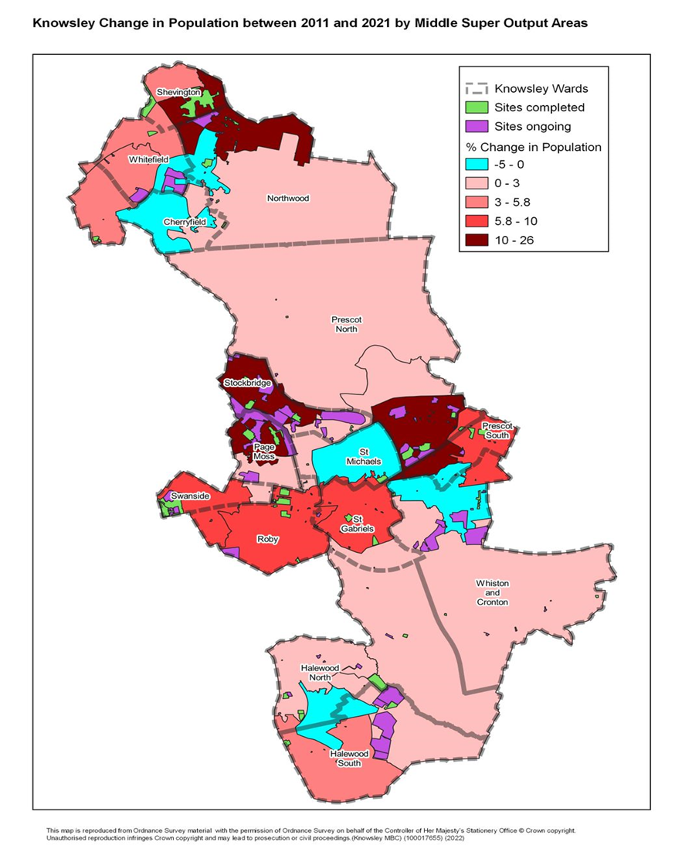
Kirkby: Population
The Knowsley Offer
Population
National Identity
Religions
Ethnicity
Qualifications
Work
Health and Disability
This maps shows the areas of population change between 2011 and 2021
Shevington and Whitefield have seen the biggest increases in population
Northwood has also seen growth
Cherryfield has seen the least growth in the area

Slide 6






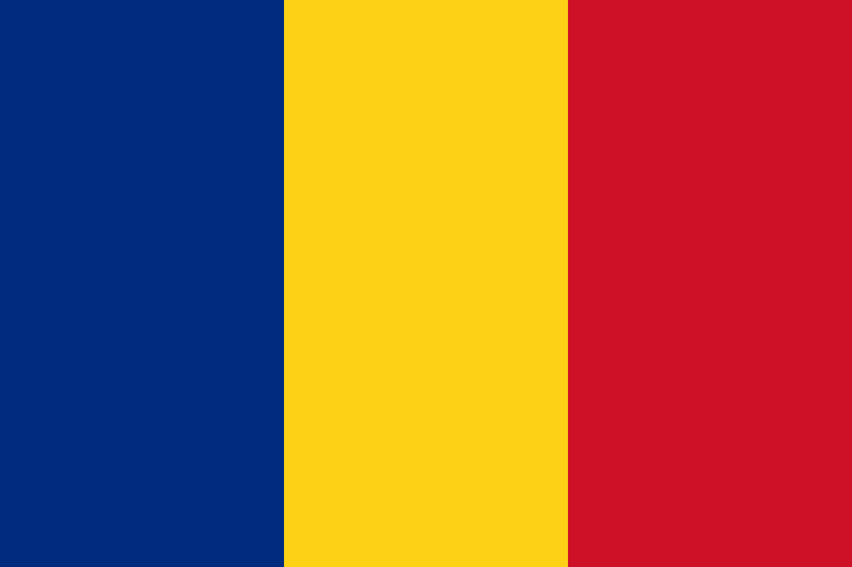

Kirkby: National Identity
94.9% of Kirkby’s population were born in the UK.
2.1% were born elsewhere but have lived in the UK for 10 years or more.
0.39% of the population have lived in the UK for less than 2 year
The Knowsley Offer
Population
National Identity
Religions
Ethnicity
Qualifications
Work
Health and Disability
Top nationalities among Kirkby Residents:
British
Polish
South American
English
Romanian
Lithuanian

Slide 7



Kirkby: Religions
67% of Kirkby’s population identify as being Christian - slightly more than the Knowsley overall 66%. Knowsley has the highest proportion of people who identify as Christian in England & Wales.
The Knowsley Offer
Population
National Identity
Religions
Ethnicity
Qualifications
Work
Health and Disability
28% of Kirkby’s population identify as having no religion. This group of people has increased the most since 2011 across Knowsley.
0.14% of Kirkby’s population identify as being Buddhist.
4.3% of people did not provide an answer to this Census question.

Slide 8

Kirkby: Ethnicity
In Huyton:
96.4% of residents are from White ethnic groups
1.6% are from Mixed or Multiple ethnic groups
0.7% are from Asian, Asian British or Asian-Welsh Backgrounds
0.8% are from Black, Black-British, Black-Welsh, Caribbean or African ethnic groups
0.6% are from Other ethnic groups.
The Knowsley Offer
Population
National Identity
Religions
Ethnicity
Qualifications
Work
Health and Disability

Slide 9
Kirkby: National Identity, Religion, and Ethnicity
Kirkby has the second highest proportion of those born in the UK out of all townships in Knowsley, after Halewood
The Knowsley Offer
Population
National Identity
Religions
Ethnicity
Qualifications
Work
Health and Disability
Kirkby has the highest proportion of those reporting as Hindu, Jewish, Muslim and Other out of all townships in Knowsley
Kirkby has the second lowest proportion of Black, Black-British, Black-Welsh, Caribbean or African, and Other ethnic groups out of all townships in Knowsley
47%
Increase in the number of Knowsley residents from Asian, Black, Mixed or other ethnic groups, since 2011.

Slide 10


Kirkby: Qualifications
24% of Kirkby township residents have no qualifications
The Knowsley Offer
Population
National Identity
Religions
Ethnicity
Qualifications
Work
Health and Disability
8.9% have Level 1 qualifications
11.6% have Level 2 qualifications
13% have Level 3 qualifications
14.5% have Level 4 qualifications or above
Nationally, Level 4 qualifications are the most common at 33.8% of residents.
The second most common category was no qualifications at 18.2%.

Slide 11

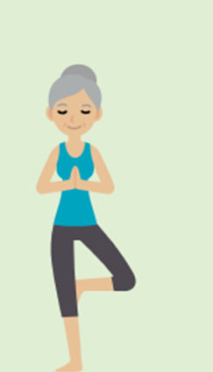

Kirkby: Work
70.1%
Economically Active
of whom 4.6% are Unemployed
29.9% Economically Inactive
The Knowsley Offer
Population
National Identity
Religions
Ethnicity
Qualifications
Work
Health and Disability
Nationally:
75.4% of the population are economically active
Of whom 4.4% are unemployed
24.6% are economically inactive
Based on those aged 16 to 64 years

Slide 12
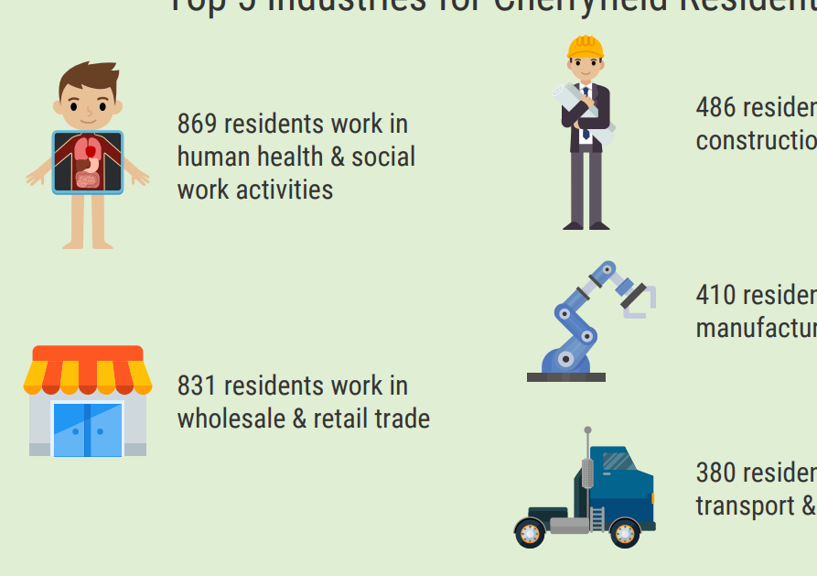



Kirkby: Work
Top 5 Industries for Kirkby Residents
The Knowsley Offer
Population
National Identity
Religions
Ethnicity
Qualifications
Work
Health and Disability
3,279 residents work in wholesale & retail trade
3,375 residents work in human health & social work activities
1,241 residents work in public sector administration
1,740 residents work in construction
1,338 residents work in education

Slide 13
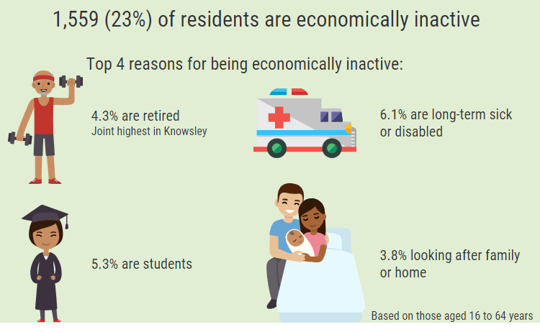
Kirkby: Work
8341 (29.9%) residents are economically inactive
Top 4 reasons for being inactive:
The Knowsley Offer
Population
National Identity
Religions
Ethnicity
Qualification
Work
Health and Disability
6.5% are retired
34.6% are long-term sick or disabled
23.3% looking after family or home
18% are students
Based on those aged 16 to 64 years

Slide 14
Kirkby: Qualifications and Work
Kirkby has the highest proportion of residents with no qualifications out of all Knowsley townships
The Knowsley Offer
Population
National Identity
Religions
Ethnicity
Qualification
Work
Health and Disability
Kirkby has the lowest proportion of residents in employment out of all townships
Kirkby has the joint highest proportion of 16–64-year-olds economically inactive because they are looking after the home or family, along with Huyton
Kirkby has the highest proportion of 16–64-year-olds economically inactive because they are long term sick or disabled
Acorn profiles show that almost 50% of employed Kirkby residents earn less than £20,000

Slide 15
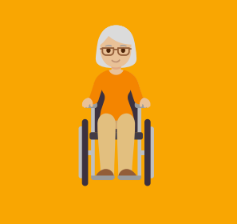
Kirkby: Health and Disability
76.1%
of Kirkby residents describe their health as good or very good
The Knowsley Offer
Population
National Identity
Religions
Ethnicity
Qualifications
Work
Health and Disability
9.7%
of Kirkby residents describe their health as bad or very bad
23.9%
23.9% of Kirkby residents describe themselves as
being disabled
47%
Of Kirkby residents face health challenges according to Acorn profiles
9,289
Kirkby residents provide unpaid care, with 2,315 residents stating that they provide 50+ hours per week of unpaid care

Slide 16
Kirkby: Health
8%
More residents reported their health as good or very good in 2021 compared to 2011
The Knowsley Offer
Population
National Identity
Religions
Ethnicity
Qualifications
Work
Health and Disability
Kirkby has the highest proportion of those rating their health bad or very bad
Kirkby has the highest proportion of those describing themselves as disabled
Kirkby has the second lowest proportion of residents providing unpaid care (18.3%), but the highest proportion of residents stating that they provide 50+ hours per week of unpaid care (4%)

