Slide 1
Census 2021
Huyton Township Profile
Wards: Page Moss, Roby, Swanside, St Michael’s, St Gabriel's, Stockbridge

Slide 3
Huyton: Population
60,147 people live in the Huyton township
Since Ward boundaries changed in 2016, the total size of Huyton’s population (estimated at 57,361 in 2016) has increased by 4.8% (2,786 in total)
Huyton is the largest township by population, followed by Kirkby then Prescot
The proportions of young people, working aged people and those 65 and older living in Huyton is typical of Knowsley overall.
Population
National Identity
Religions
Ethnicity
Qualifications
Work
Health and Disability
23.6%
59.1%
17.3%
Of residents are aged 0-19 years old
Of residents are aged 20-64 years old
Of residents are aged 65+ years old

Slide 4
Huyton: Population
Between 2011 and 2021…
The ward boundaries changed between the two censuses, in 2011 the wards that made up Huyton were: Longview, Page Moss, Roby, St Bartholomews, St Gabriels, Stockbridge, and Swanside
It can be estimated that:
There has been a 22% increase in total population (49,301 in 2011 to 60,147 in 2021)
The biggest increase in population was in the 85 years and older category (65%), followed by the 60-64 years (47%), then the 25-29 years (44%)
16-19 years category saw the largest decrease (-12%), followed by 20-24 years (-4%), these were the only two age categories where the population did not increase.
This is typical of Knowsley as a whole, with significant population dips in these age groups.
Population
National Identity
Religions
Ethnicity
Qualifications
Work
Health and Disability

Slide 5
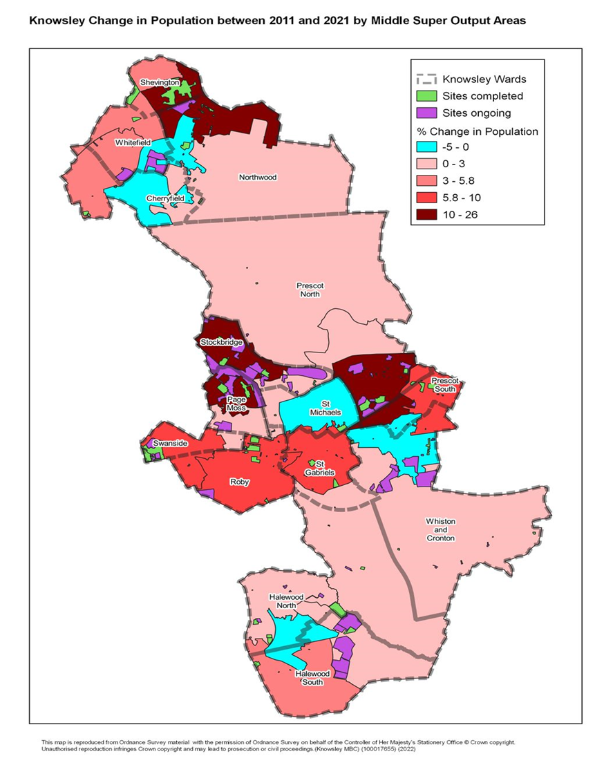
Huyton: Population
Population
National Identity
Religions
Ethnicity
Qualifications
Work
Health and Disability
This maps shows the areas of population change between 2011 and 2021
Stockbridge and Page Moss have seen the biggest increases in population
Swanside, Roby and St Gabriels have also seen a large amount of growth
St Michaels has seen the least growth in the area

Slide 6
Huyton: National Identity
94.7% of Huyton’s population were born in the UK.
2.5% were born elsewhere but have lived in the UK for 10 years or more.
0.56% of the population have lived in the UK for less than 2 year
Population
National Identity
Religions
Ethnicity
Qualifications
Work
Health and Disability
Top nationalities among Huyton Residents:
British
Polish
Lithuanian
English
Romanian
Irish

Slide 7
Huyton: Religions
67% of Huyton’s population identify as being Christian - slightly more than the Knowsley overall 66%. Knowsley has the highest proportion of people who identify as Christian in England & Wales.
Population
National Identity
Religions
Ethnicity
Qualifications
Work
Health and Disability
26% of Huyton’s population identify as having no religion. This group of people has increased the most since 2011 across Knowsley.
0.17% of Huyton’s population identify as being Buddhist.
5.2% of people did not provide an answer to this Census question.

Slide 8
Huyton: Ethnicity
In Huyton:
95.2% of residents are from White ethnic groups
1.5% are from Asian, Asian-British or Asian-Welsh Backgrounds
1.7% are from Mixed or Multiple ethnic groups
0.9% are from Black, Black-British, Black-Welsh, Caribbean or African ethnic groups
0.6% are from Other ethnic groups.
Population
National Identity
Religions
Ethnicity
Qualifications
Work
Health and Disability

Slide 9
Huyton: National Identity, Religion, and Ethnicity
Huyton has the lowest proportion of those born in the UK out of all townships in Knowsley
Population
National Identity
Religions
Ethnicity
Qualifications
Work
Health and Disability
Huyton has the highest proportion of those reporting as Hindu, Jewish, Muslim and Other out of all townships in Knowsley
Huyton has the highest proportion of Black, Black-British, Black-Welsh, Caribbean or African, and Other ethnic groups out of all townships in Knowsley
81%
Increase in the number of Knowsley residents from Asian, Black, Mixed or other ethnic groups, since 2011.

Slide 10
Huyton: Qualifications
21.% of Huyton township residents have no qualifications.
Population
National Identity
Religions
Ethnicity
Qualifications
Work
Health and Disability
8.3% have Level 1 qualifications
11.2% have Level 2 qualifications
13.8% have Level 3 qualifications
19.7% have Level 4 qualifications or above
Nationally, Level 4 qualifications are the most common at 33.8% of residents.
The second most common category was no qualifications at 18.2%.

Slide 11
Huyton: Work
72.6%
Economically Active
of whom 4.5% are Unemployed
27.3% Economically Inactive
Population
National Identity
Religions
Ethnicity
Qualifications
Work
Health and Disability
Nationally:
75.4% of the population are economically active
Of whom 4.4% are unemployed
24.6% are economically inactive
Based on those aged 16 to 64 years

Slide 12
Huyton: Work
Top 5 Industries for Stockbridge Residents
Population
National Identity
Religions
Ethnicity
Qualifications
Work
Health and Disability
4,235 residents work in wholesale & retail trade
5,061 residents work in human health & social work activities
1,966 residents work in public sector administration
2,665 residents work in construction
2,665 residents work in education

Slide 13
Huyton: Work
10,401 (27.4%) residents are economically inactive
Top 4 reasons for being inactive:
Population
National Identity
Religions
Ethnicity
Qualification
Work
Health and Disability
9.1% are retired
32.4% are long-term sick or disabled
23.3% looking after family or home
19.1% are students
Based on those aged 16 to 64 years

Slide 14
Huyton: Qualifications and Work
Huyton has the lowest proportion of residents with no qualifications out of all Knowsley townships
Population
National Identity
Religions
Ethnicity
Qualification
Work
Health and Disability
Huyton has the second lowest proportion of residents in employment out of all townships, following Kirkby
Huyton has the joint highest proportion of 16–64-year-olds economically inactive because they are looking after the home or family, along with Kirkby
Huyton has the second highest proportion of 16–64-year-olds economically inactive because they are long term sick or disabled, following Kirkby
Acorn profiles show that 44% of employed Huyton residents earn less than £20,000 and 31% earn between £20,000 and £40,000

Slide 15
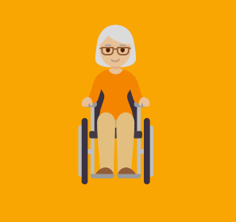
Huyton: Health and Disability
77.5%
of Huyton residents describe their health as good or very good.
Population
National Identity
Religions
Ethnicity
Qualifications
Work
Health and Disability
8.8%
of Huyton residents describe their health as bad or very bad.
22.7%
22.7% of Huyton residents describe themselves as
being disabled.
34.5
Of Huyton residents face health challenges according to Acorn profiles.
Huyton residents provide unpaid care, with 2,378 residents stating that they provide 50+ hours per week of unpaid care.
10,304

Slide 16
Huyton: Health
25.7%
More residents reported their health as good or very good in 2021 compared to 2011
Population
National Identity
Religions
Ethnicity
Qualifications
Work
Health and Disability
Huyton has the second highest proportion of those rating their health bad or very bad, after Kirkby (9.7%)
Huyton has the second highest proportion of those describing themselves as disabled, after Kirkby (23.9%)
Huyton has the lowest proportion of residents providing unpaid care (18.3%), but the second highest proportion of residents stating that they provide 50+ hours per week of unpaid care (4%)

