Slide 1
Census 2021
Halewood Township Profile
Wards: Halewood North, Halewood South

Slide 3
Halewood: Population
20,755 people live in the Halewood township
Since Ward boundaries changed in 2016, the total size of Halewood’s population (estimated at 20,471 in 2016) has slightly increased by 1.4% (284 in total)
Halewood is the smallest township by population
The proportions of young people, working aged people and those 65 and older living in Halewood is similar to Knowsley overall, but Halewood has a slightly smaller youth population and a slightly larger older population.
The Knowsley Offer
Population
National Identity
Religions
Ethnicity
Qualifications
Work
Health and Disability
22.1%
59.8%
18.1%
Of residents are aged 0-19 years old
Of residents are aged 20-64 years old
Of residents are aged 65+ years old

Slide 4
Halewood: Population
Between 2011 and 2021…
The ward boundaries changed between the two censuses, in 2011 the wards that made up Halewood were: Halewood North, Halewood South and Halewood West
It can be estimated that:
There has been a 3.1% increase in total population (20754 in 2021 and 20,116 in 2011)
The biggest increase in population was in the 60 to 64 years category (33.2%), followed by the 65 years and older (18.7%).
The 20 to 24 years category saw the largest decrease (-41.5%), followed by 16 to 19 years (-18.5%), there was also decreases in the 45 to 59 years (-6.2%) and under 15 (-5%)
This is typical of Knowsley as a whole, with significant population dips in these age groups
The Knowsley Offer
Population
National Identity
Religions
Ethnicity
Qualifications
Work
Health and Disability

Slide 5
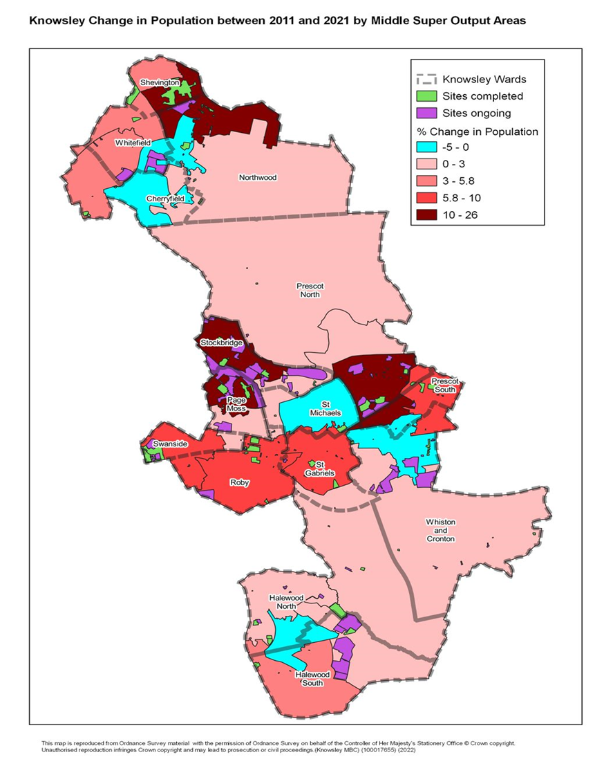
Halewood: Population
The Knowsley Offer
Population
National Identity
Religions
Ethnicity
Qualifications
Work
Health and Disability
This maps shows the areas of population change between 2011 and 2021
Halewood South has saw the biggest increases in population
There has been a bigger decrease in population in the middle of Halewood
There are a number of new houses being built in Halewood and so the towns population is expected to grow

Slide 6
Halewood: National Identity
94.1% of Halewood’s population were born in the UK.
2.7% were born elsewhere but have lived in the UK for 10 years or more.
0.17% of the population have lived in the UK for less than 2 year
The Knowsley Offer
Population
National Identity
Religions
Ethnicity
Qualifications
Work
Health and Disability
Top nationalities among Halewood Residents:
British
Polish
Romanian
English
Welsh
Lithuanian

Slide 7
Halewood: Religions
66% of Halewood’s population identify as being Christian, the same as Knowsley overall. Knowsley has the highest proportion of people who identify as Christian in England & Wales.
The Knowsley Offer
Population
National Identity
Religions
Ethnicity
Qualifications
Work
Health and Disability
28% of Halewood’s population identify as having no religion. This group of people has increased the most since 2011 across Knowsley.
0.7% of Halewood’s population identify as being Muslim.
0.2% of Halewood’s population identify as being Buddhist.
4.9% of people did not provide an answer to this Census question.

Slide 8
Halewood: Ethnicity
In Halewood:
94.3% of residents are from White ethnic groups
2.4% are from Mixed or Multiple ethnic groups
1.8% are from Asian, Asian-British or Asian-Welsh Backgrounds
0.7% are from Black, Black-British, Black-Welsh, Caribbean or African ethnic groups
0.4% are from Other ethnic groups.
The Knowsley Offer
Population
National Identity
Religions
Ethnicity
Qualifications
Work
Health and Disability

Slide 9
Halewood: National Identity, Religion, and Ethnicity
Halewood has the highest proportion of those born in the UK out of all townships in Knowsley
The Knowsley Offer
Population
National Identity
Religions
Ethnicity
Qualifications
Work
Health and Disability
Halewood has the highest proportion of those reporting as Muslim out of all townships in Knowsley
Halewood has the highest proportion of Mixed or Multiple ethnic groups out of all townships in Knowsley
48%
Increase in the number of Halewood residents from Asian, Black, Mixed or other ethnic groups, since 2011.

Slide 10
Halewood: Qualifications
22.6% of Halewood township residents have no qualifications
The Knowsley Offer
Population
National Identity
Religions
Ethnicity
Qualifications
Work
Health and Disability
10.5% have Level 1 qualifications
14.7% have Level 2 qualifications
17.8% have Level 3 qualifications
26.3% have Level 4 qualifications or above
Nationally, Level 4 qualifications are the most common at 33.8% of residents.
The second most common category was no qualifications at 18.2%.

Slide 11
Halewood: Work
74.7%
Economically Active
of whom 4.3% are Unemployed
25.3% Economically Inactive
The Knowsley Offer
Population
National Identity
Religions
Ethnicity
Qualifications
Work
Health and Disability
Nationally:
75.4% of the population are economically active
Of whom 4.4% are unemployed
24.6% are economically inactive
Based on those aged 16 to 64 years

Slide 12
Halewood: Work
Top 5 Industries for Halewood Residents
The Knowsley Offer
Population
National Identity
Religions
Ethnicity
Qualifications
Work
Health and Disability
1,543 residents work in wholesale & retail trade
1,548 residents work in human health & social work activities
947 residents work in manufacturing
838 residents work in construction
709 residents work in public sector administration
1,030 residents work in education

Slide 13
Halewood: Work
2,284 (25.3%) residents are economically inactive
Top 4 reasons for being inactive:
The Knowsley Offer
Population
National Identity
Religions
Ethnicity
Qualification
Work
Health and Disability
14.8% are retired
29.5% are long-term sick or disabled
19% looking after family or home
20.9% are students
Based on those aged 16 to 64 years

Slide 14
Halewood: Qualifications and Work
Halewood has the second lowest proportion of residents with no qualifications out of all Knowsley townships
The Knowsley Offer
Population
National Identity
Religions
Ethnicity
Qualification
Work
Health and Disability
Halewood has the second highest proportion of residents in employment out of all townships
Halewood has the highest proportion of 16–64-year-olds economically inactive because they have retired out of all townships in Knowsley
Kirkby has the highest proportion of 16–64-year-olds economically inactive because they are students
Acorn profiles show that almost 39% of employed Halewood residents earn less than £20,000 and around 30% earn £20,000 to £40,000

Slide 15
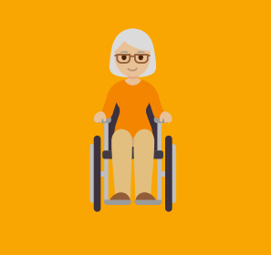
Halewood: Health and Disability
79.3%
of Halewood residents describe their health as good or very good
The Knowsley Offer
Population
National Identity
Religions
Ethnicity
Qualifications
Work
Health and Disability
7.6%
of Halewood residents describe their health as bad or very bad
20.9%
20.9% of Halewood residents describe themselves as
being disabled
37.6%
Acorn profiles suggest that 37.6% of residents in Halewood face health challenges
2,221
Halewood residents provide unpaid care, with 712 residents stating that they provide 50+ hours per week of unpaid care

Slide 16
Halewood: Health
3.2%
More residents reported their health as good or very good in 2021 compared to 2011
The Knowsley Offer
Population
National Identity
Religions
Ethnicity
Qualifications
Work
Health and Disability
Halewood has the highest proportion of those rating their health good or very good
Halewood has the second lowest proportion of those describing themselves as disabled
Halewood has the highest proportion of residents providing unpaid care (19%), but the lowest proportion of residents stating that they provide 50+ hours per week of unpaid care (3.6%)

